Slide 1
Multi-View 2D Image-Based 3D
Modeling of Objects
GROUP 11
Jugal Vaghmashi [AU2340017]
Rena Malhotra [AU2340018]
Siya Dhaduk [AU2340022]
Jayvat Shah [AU2340027]

Slide 2
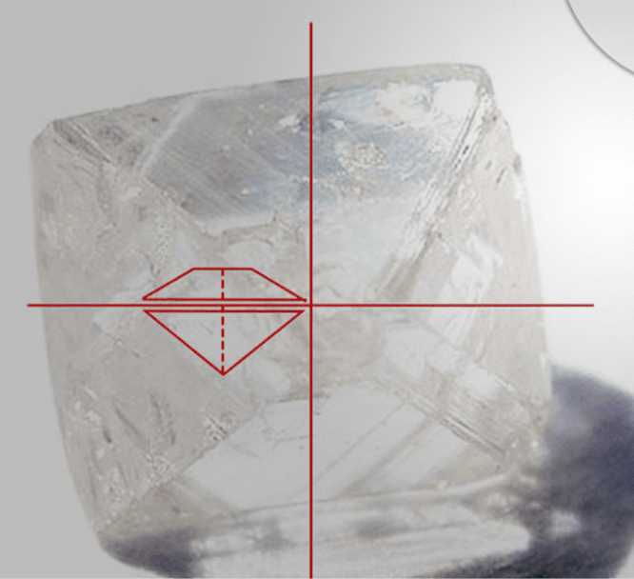
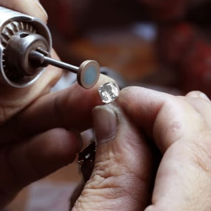
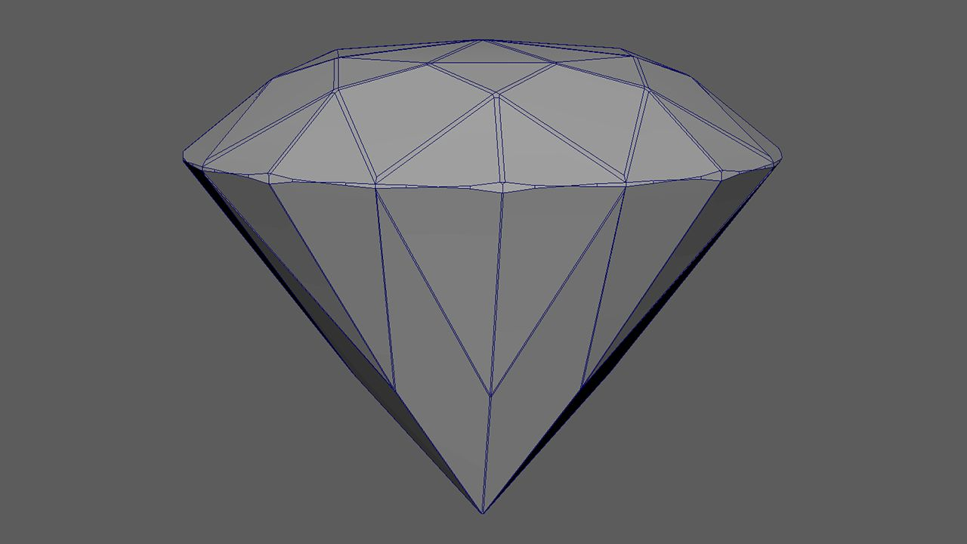
Introduction
Realistic 3D model generation from 2D images
Motivation: Diamonds’ precision geometry requires accurate 3D visualization
Aim: To reconstruct a 3D diamond stone model using multiple 2D silhouette projections
Applications: 3D modeling, virtual visualization, Reconciling for laser cutting
Free3D. (n.d.). Diamond 3D model [3D model]. Free3D. https://free3d.com/3d-model/diamond-3d-2855.html
SLTL Group. (n.d.). What is diamond processing? SLTL. https://www.sltl.com/what-is-diamond-processing/?srsltid=AfmBOorHbz9801OMMlAYemqO4Mb-vViZGohuBv6PwcDWCEYIt_GIQ8pi

Slide 3
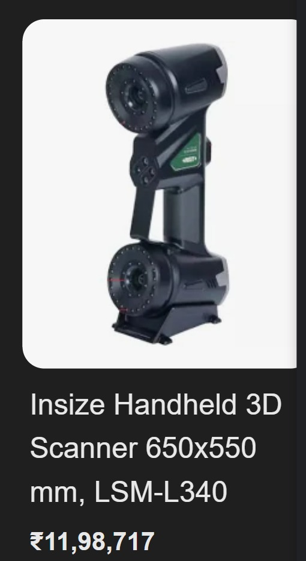
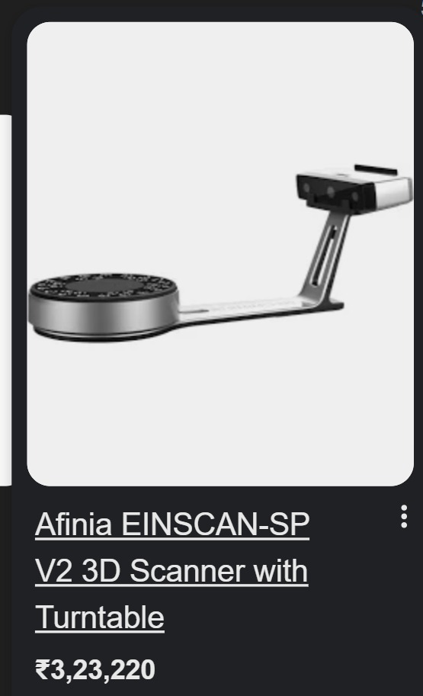
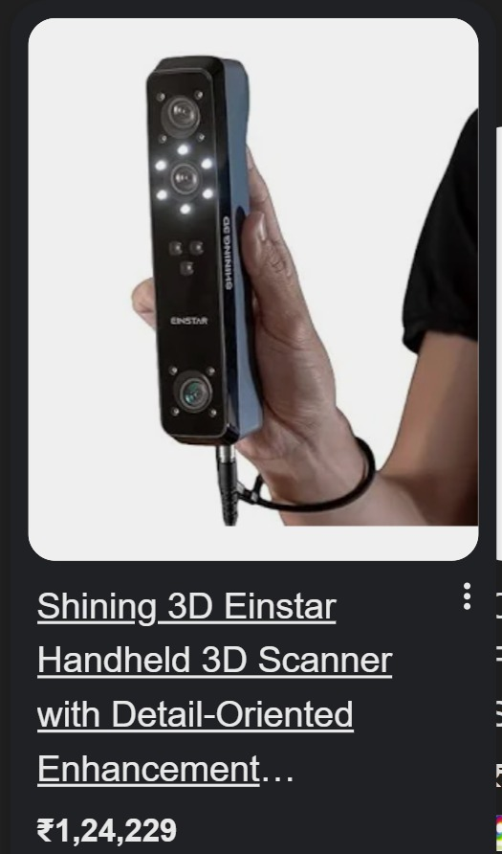
DesertCart. (n.d.). Shining 3D Einstar handheld 3D scanner with detail-oriented enhancement [Product]. DesertCart. https://www.desertcart.in/products/490281036-shining-3d-einstar-handheld-3d-scanner-with-detail-oriented-enhancement
Tanotis. (n.d.). Afinia Einscan SP v2 3D scanner with turntable [Product]. Tanotis. https://www.tanotis.com/products/afinia-einscan-sp-v2-3d-scanner-with-turntable?srsltid=AfmBOorEgV0iKuS6XC0BaTnXuSLetztvha3OFbSigEQrjNZjTNgCuAWbgDA
IndustryBuying. (n.d.). Insize 3D printers [Product]. IndustryBuying. https://www.industrybuying.com/3d-printers-insize-IND.3DP.632953547

Slide 4
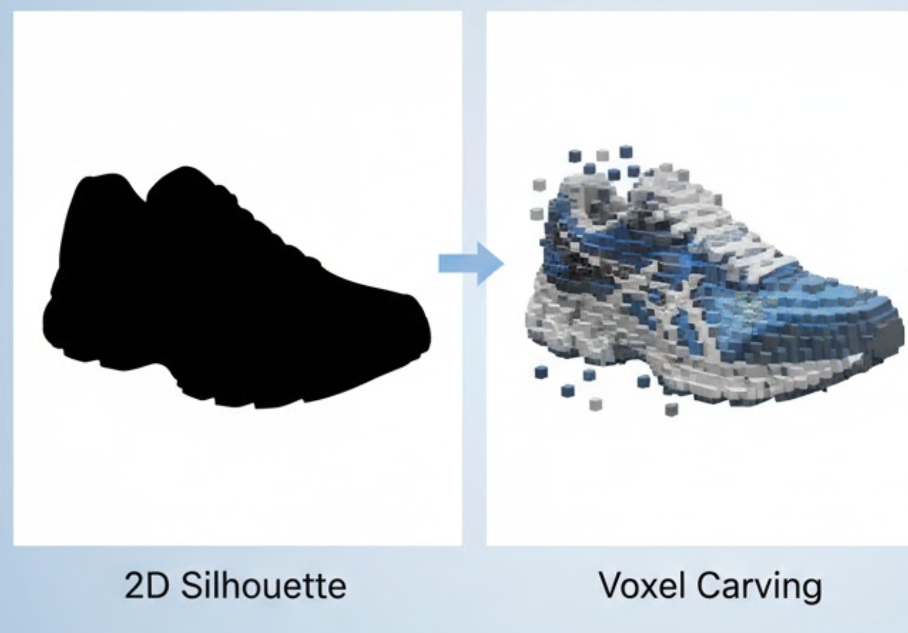
Literature Review
Previous works explored multi-view 3D reconstruction using image silhouettes.
ITM Conferences (2024) – Focused on voxel carving from silhouette images.
Our approach adapts these principles to diamond images for accurate 3D shape recovery.

Slide 5
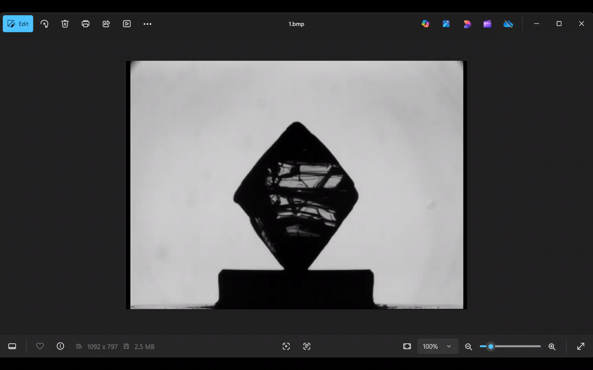
Dataset
200 images of a single diamond stone
Captured at 1.8° rotation difference per image
Format: BMP
Each image includes the diamond on a uniform background
Used for multi-angle projection and voxel carving

Slide 6
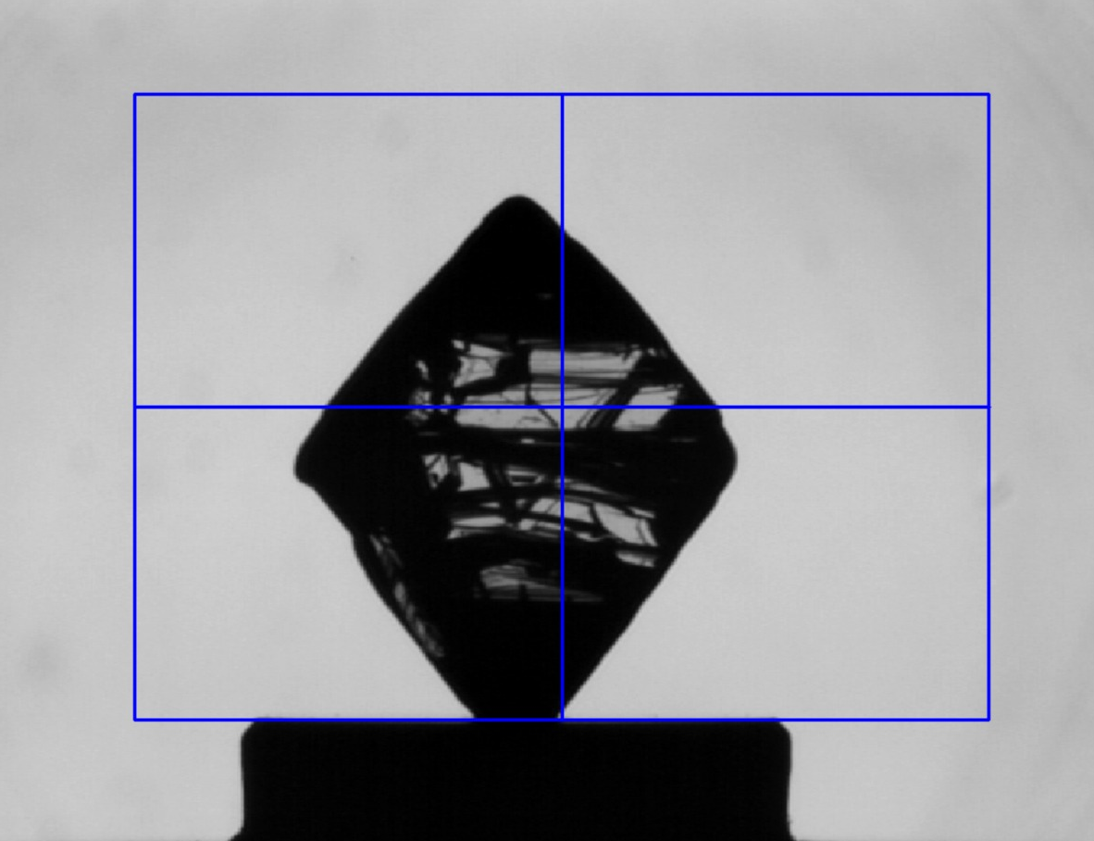
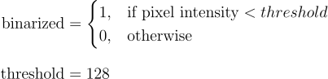
Methodology
Selection of diamond area
ROI SELECTION
2. CREATING CLEAN SILHOUETTE
Binarization
Gap Filling
Fill internal gaps for smooth shape.

Slide 7
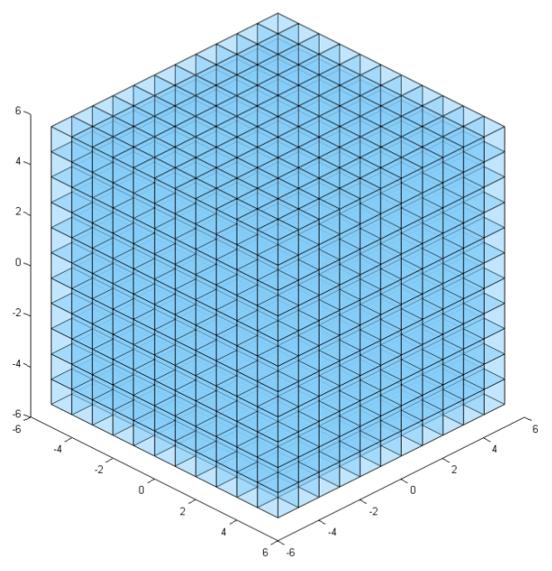
Methodology
Regular 3D voxel grid [1]
3. Voxel Grid Creation
Voxel (volume element) - 3D
equivalent of a pixel
Normalized 3D space for
analyzing 3D objects
[1] Regular 3D voxel grid—unoccupied. https://www.researchgate.net/publication/324389722/figure/fig3/AS:11431281391286952@1745321870314/Regular-3D-voxel-grid-unoccupied.tif

Slide 8

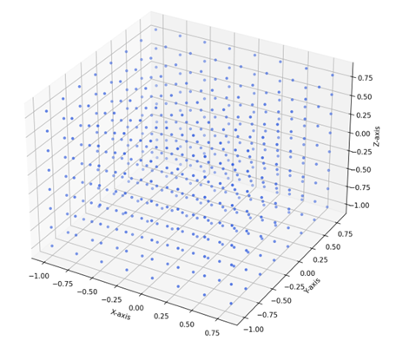
Results
Generated Silhouette
Voxel Grid

Slide 9
Conclusion
Successful Proof of concept: Generation of 2-D silhouette images.
Cost effective alternative: Cost effective instead of expensive commercial scanners & other devices.
Setting up of Voxel Grid: Normalized 3D voxel grid prepared for analysis and subsequent carving to approximate the visual hull.

Slide 10
Next Set of Work
Visual Hull : Implementing the 3D reconstruction algorithm by carving a voxel grid using the generated silhouettes.
Sphere Carving : Validating the concept of visual hull through a simulation.
Resolution Testing: Using different grid densities to analyze the output.
Autonomous Threshold: Replacing the manual thresholding in the binarization step with an automated algorithm.
Interactive Web UI Dashboard: Developing a web-interface for uploading images of the diamond and the final 3-D images generated.

Slide 11
References
[1] Regular 3D voxel grid—unoccupied. https://www.researchgate.net/publication/324389722/figure/fig3/AS:11431281391286952@1745321870314/Regular-3D-voxel-grid-unoccupied.tif
[2] 2D to 3D image conversion algorithms. (n.d.-a). https://www.itm-conferences.org/articles/itmconf/pdf/2024/07/itmconf_icacs2024_01010.pdf

